Slide 1
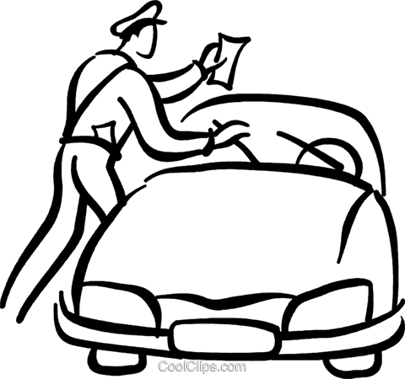
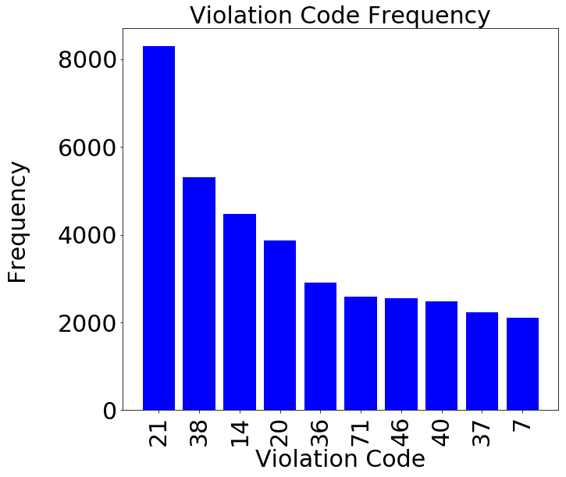
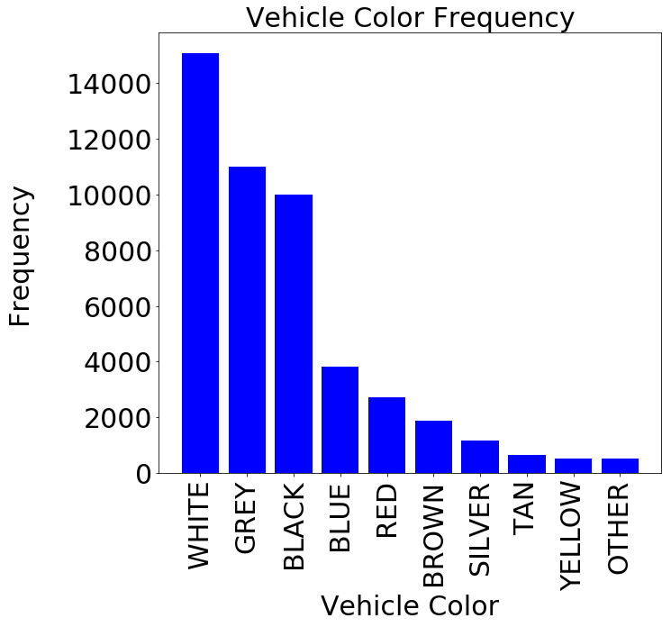
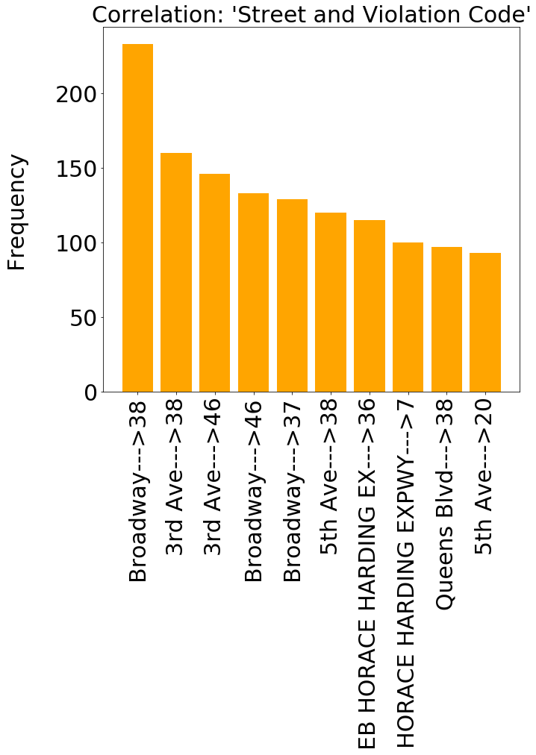
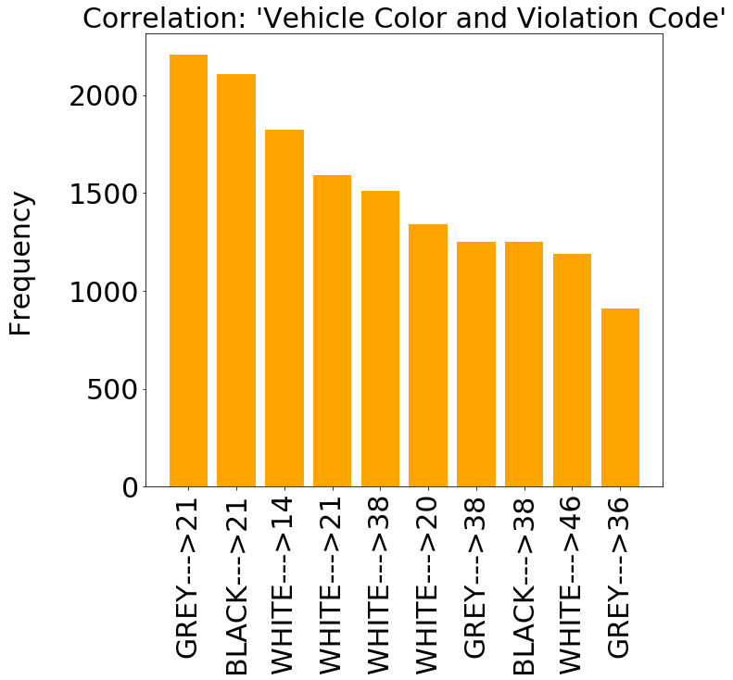
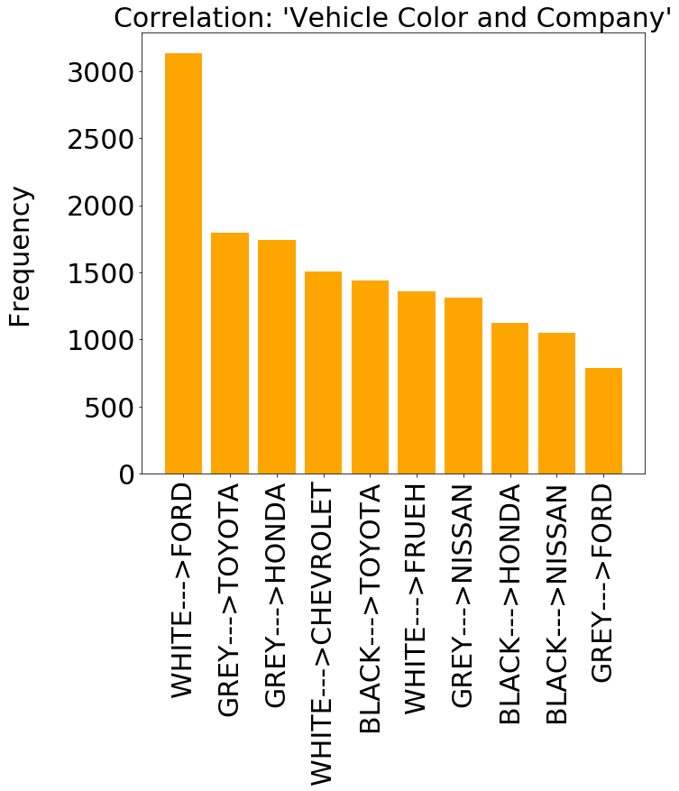
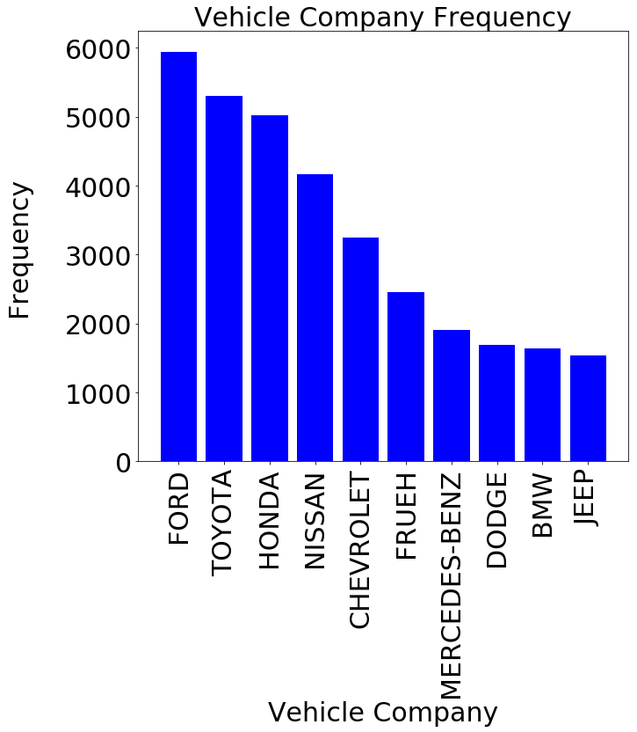
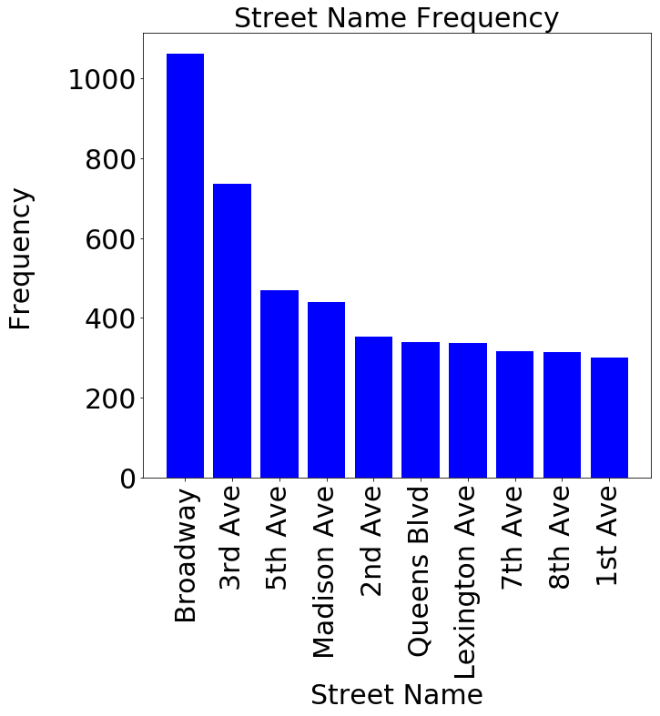
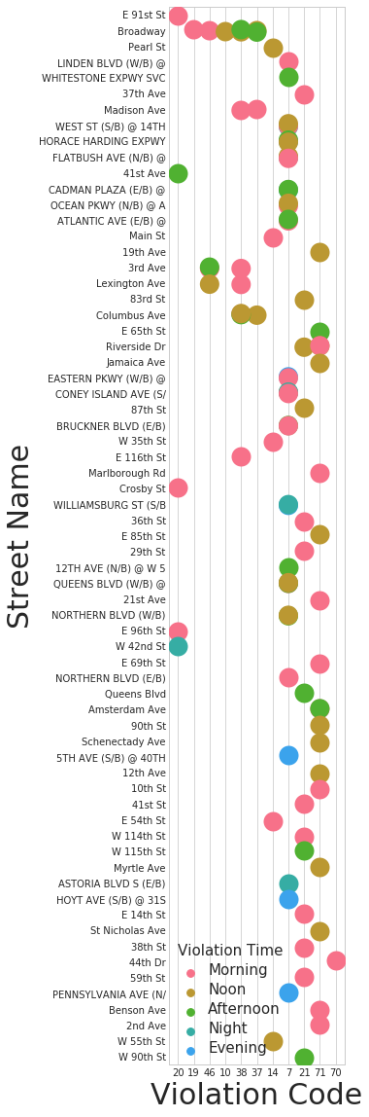
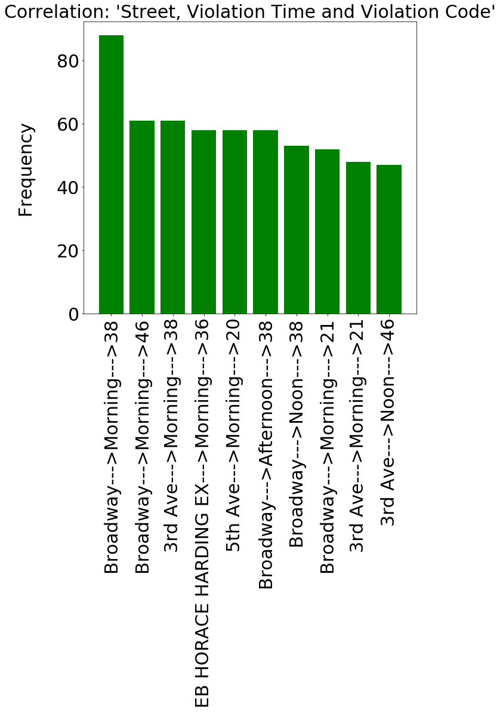
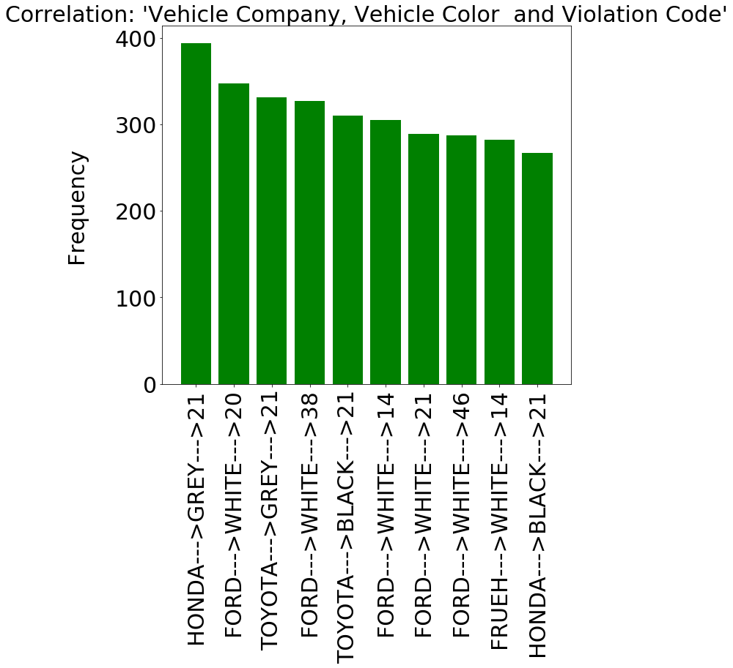
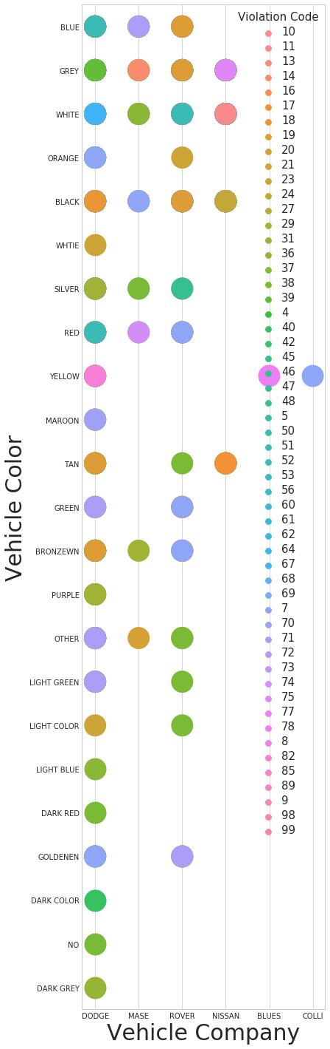
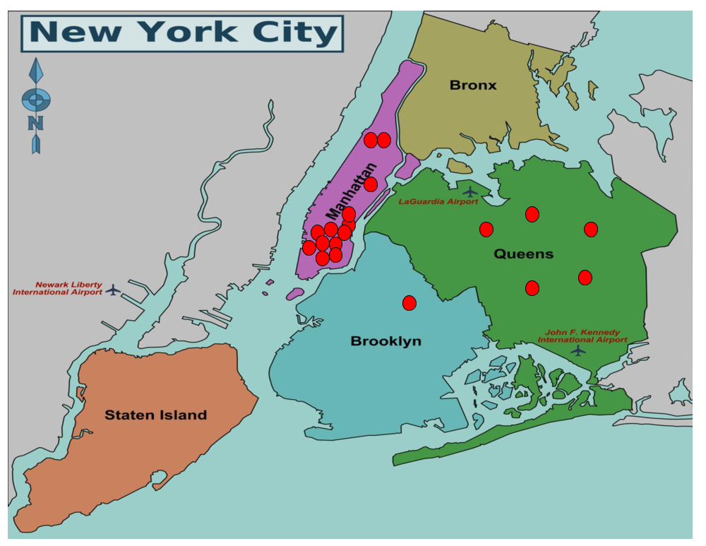
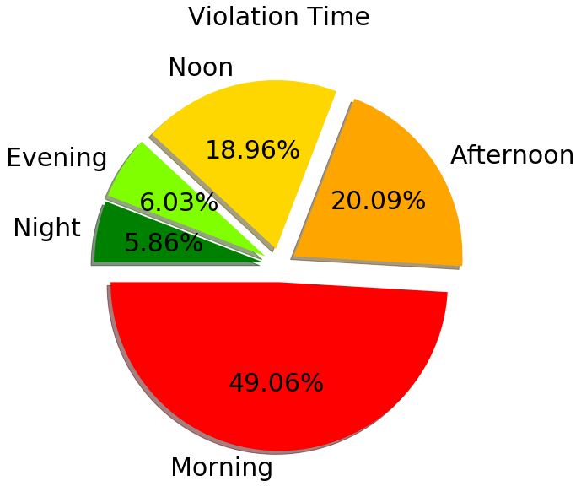
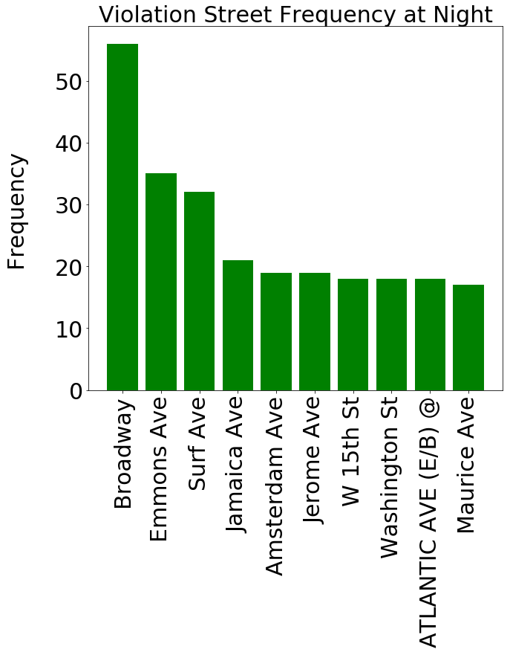
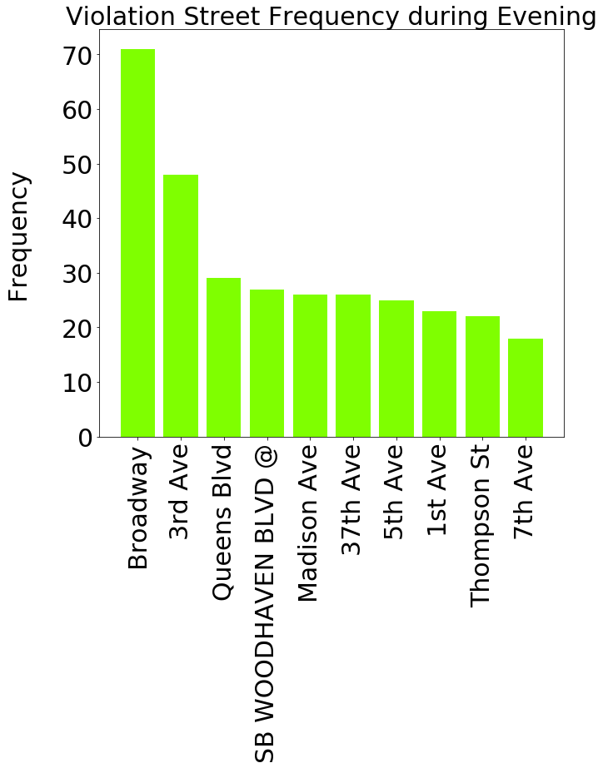
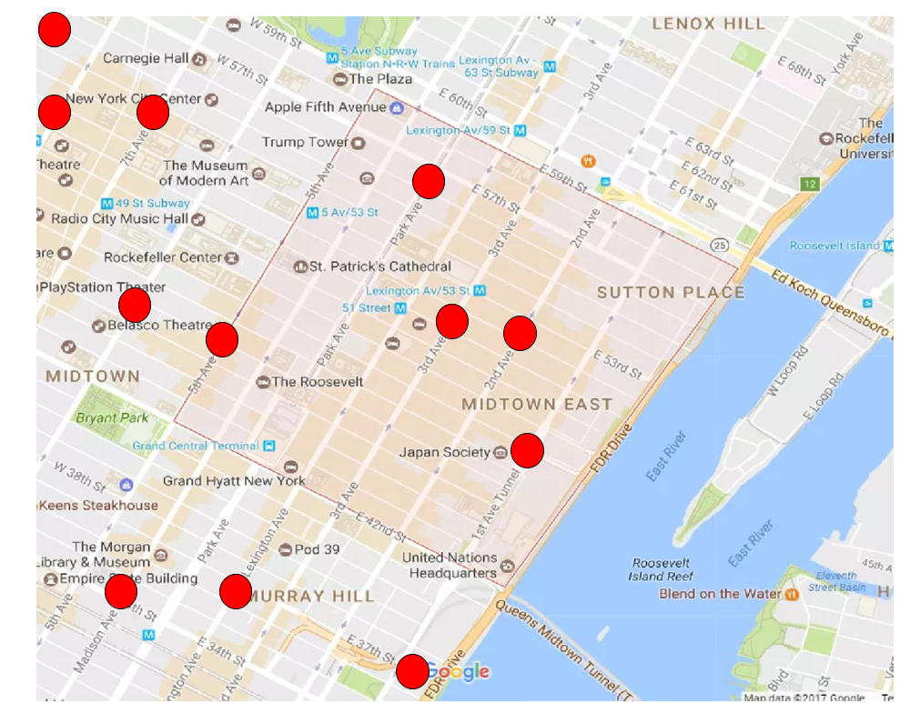
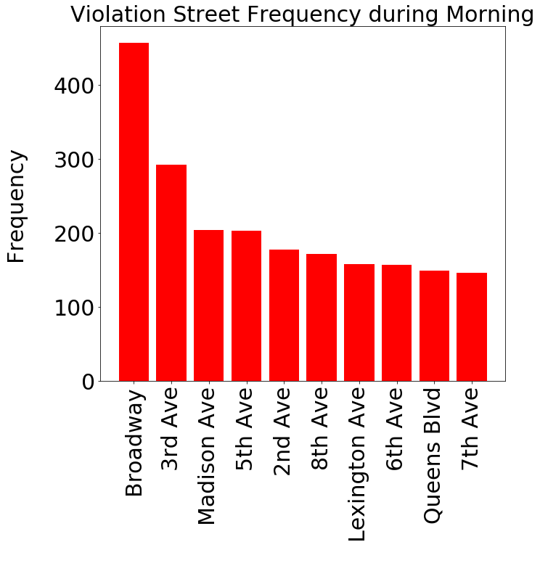
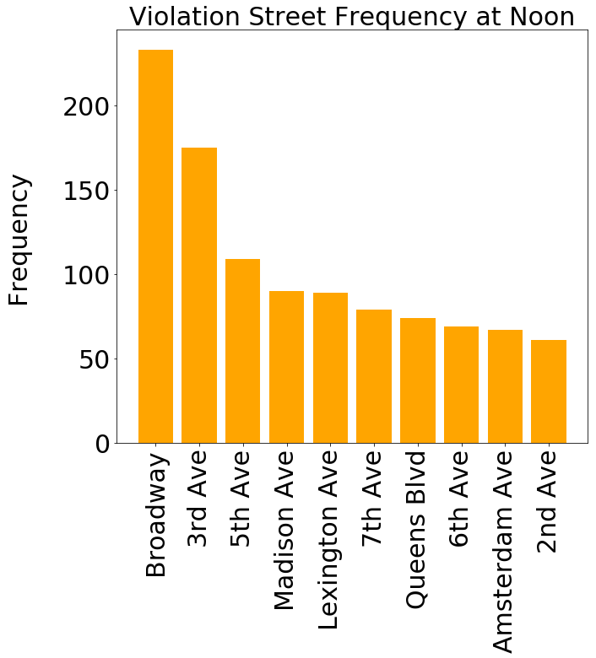
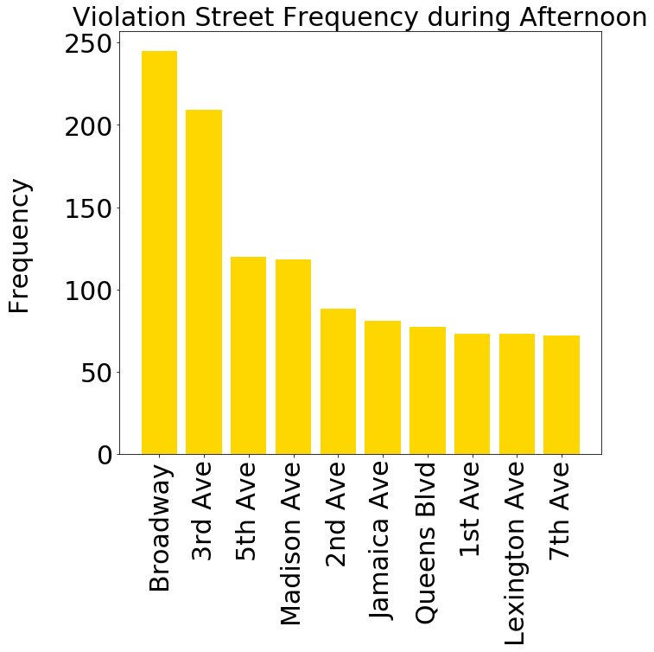
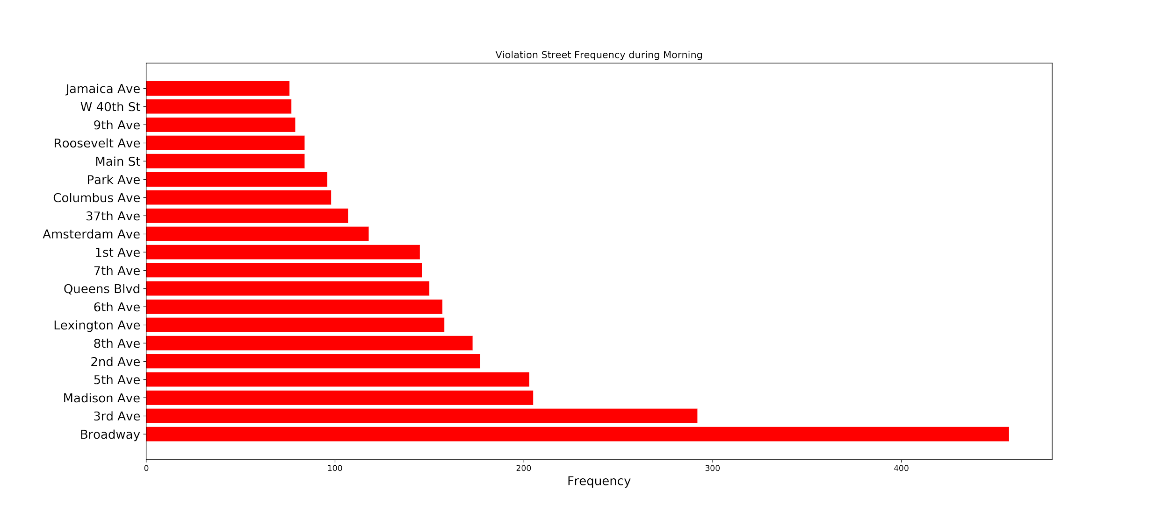
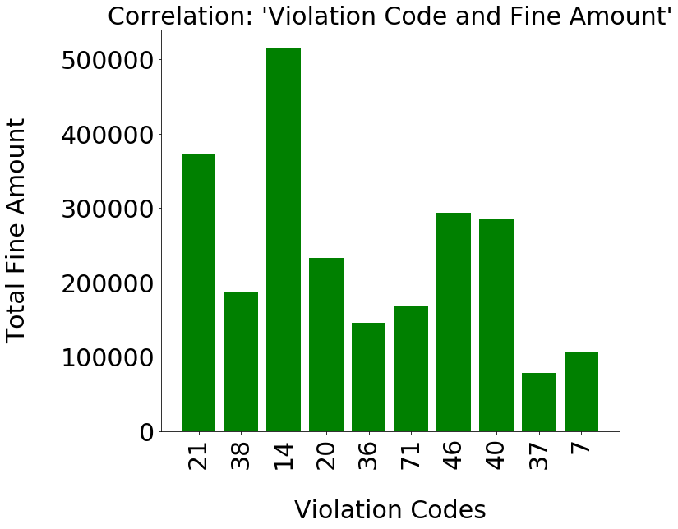
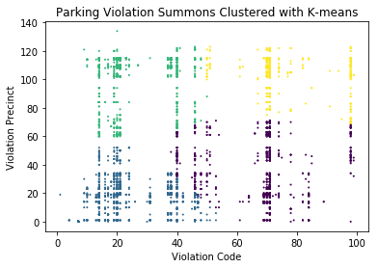
Likelihood and Correlation Estimation of NYC Parking Violations: A scalable approach using PySpark
Maria Mahbub¹ and Tasmia Rahman²
Bredesen Center, UTK & ORNL¹, EECS, UTK²
Motivation
Data Sets
Where and when are tickets most likely to be issued?
What type of codes are mostly violated?
What are the most common color and types of cars to be ticketed?
How much NYC is earning from parking violations?
NYC Parking Violations Data- Fiscal year 2019*:
3.95 million data points with 43 dimensions
Supporting Dataset: 99 Parking Violation Codes* with fine amount and descriptions
*Provider: US Department of Finance
Data Analysis Workflow (Scalable)
Data Preprocessing
Data Analysis
Data Visualization
Tool: Pandas
Platform , Framework & Tools: JetStream, Apache PySpark, Pandas
Tool: Matplotlib
NYC Open Data
Filter missing values
Fix inconsistencies
Remove irrelevant attributes
Split the time
Incorporate fine data
Sample randomly from the dataset
50000 Sample Data
Likelihood Analysis:
Observe frequency of factors using MapReduce that scales to larger dataset
Pattern Analysis:
Build maps for correlation analysis of different features
Generate likelihood correlations
Likelihood Analysis
Bar Plot
Pie Chart
Pattern Analysis
Scatter Plot
Raw Data
Parallelization
Visualization
Fine Amount
Prepared Data
PySpark context to build rdds
Supporting Data
Analysis and Findings
Likelihood Analysis
Correlation Analysis
Which codes seem to get violated the most?
Are there some common car companies that get tickets issued frequently, or color?
Is there any risky street?
What happens when 2 categories are paired? Does it make any difference?
Code 21 is most violated when paired with a color
When paired with street, 38 seems to be most violated
White, grey colors prove to remain most likely even when paired with others
Most occurred violation codes, car companies and streets are analyzed with Map Reduce
Mostly violated
Code: 21,38,14
21: No parking sign violation
38: Failing to show a receipt or tag in the windshield.
14: Standing not allowed
Street: Broadway, 3rd Ave, 5th Ave
Vehicle Company : Ford, Toyota, Honda
Vehicle Color: White, Grey and Black
What happens when 3 categories are grouped? Are they somewhat correlated?
Can we estimate the time of the day when tickets are most likely to be issued?
If we can what are their relationship with any specific street?
Map of Boroughs of New York City
Street Distribution during different time period
Correlation: Violation Time, Violation Code & Street Name
Violation codes do not have a uniform relationship with street and time period
21 is the most violated in most of the streets
At night, we do not see much violation issuance
Almost all streets in New York gets violation issuance in the morning
21 is the most violated code even when it is correlated with car’s company and its color
For most companies, white colored cars get most of the parking violation tickets
Correlation: Vehicle Company, Color & Violation Code
Midtown East Manhattan
Add dimensions to the clustering model
Build prediction algorithm to predict parking violations based on other features
Group similar violation codes
Likelihood analysis of the features reveals the frequency of violation
Pattern analysis can demonstrate a correlation among the features
Incorporating fine amount have also provided insights on the revenue generation
Future Work:
Conclusion:
Morning is the most busy time, hence parking codes are most likely to get violated during this time
Broadway is the riskiest zone regardless of time period
Fine amount for code 14 is higher than that of code 21 ---> hence more revenue from code 14

